Slide 1


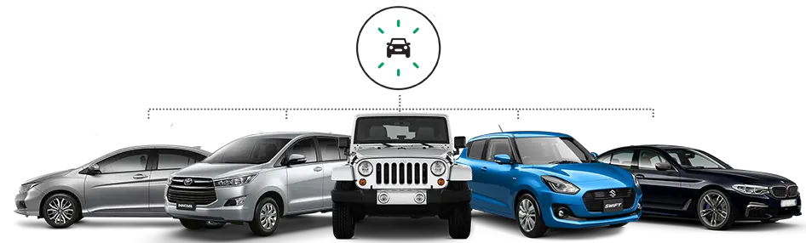
CAR RENTAL MANAGEMENT SYSTEM
“DEPARTMENT OF COMPUTER SCIENCE AND ENGINEERING”
DBMS MINI PROJECT ON
“CAR RENTAL MANAGEMENT SYSTEM”
SUBJECT CODE:22CLU403
FACALTY INCHARGE :VEENA POTDAR

Slide 2

CAR RENTAL MANAGEMENT SYSTEM

Slide 3

Our Team:
SUMANT SHET
1DA22CS168
VACHAN U S
1DA22CS178
SUHAS P
1DA22CS166

Slide 4
INTRODUCTION TO THE MINI WORLD
A Car Rental Management System is looking to develop a state-of-the-art car rental portfolio management system which is able to track their car rental booking history and billing and car details. This system facilitates the owner of the Car Rental Company to retrieve, update and track and delete the bookings and cars efficiently. It can utilize this system to monitor their financial management.
Car Rental Management System is a database management system (DBMS) which is based on computer networks, using the advance database technology to construct, maintain and update various kinds of data in data base system. The DBMS can track and update all the information of the cars available and customers during a particular time span.
The major advantages of the DBMS are easy to retrieve and update information, efficient data sharing and communication and reliable backup and security. Information about cars is done by just writing the car name, car model and insurance details. Whenever a new car is added to the company its information is stored freshly. Bills are generated by recording the usage of the car by the customer. Details of the customer are updated on a written sheet and at last, they all summed up. Car usage details are recorded on the document, which contains the customer information.

Slide 5
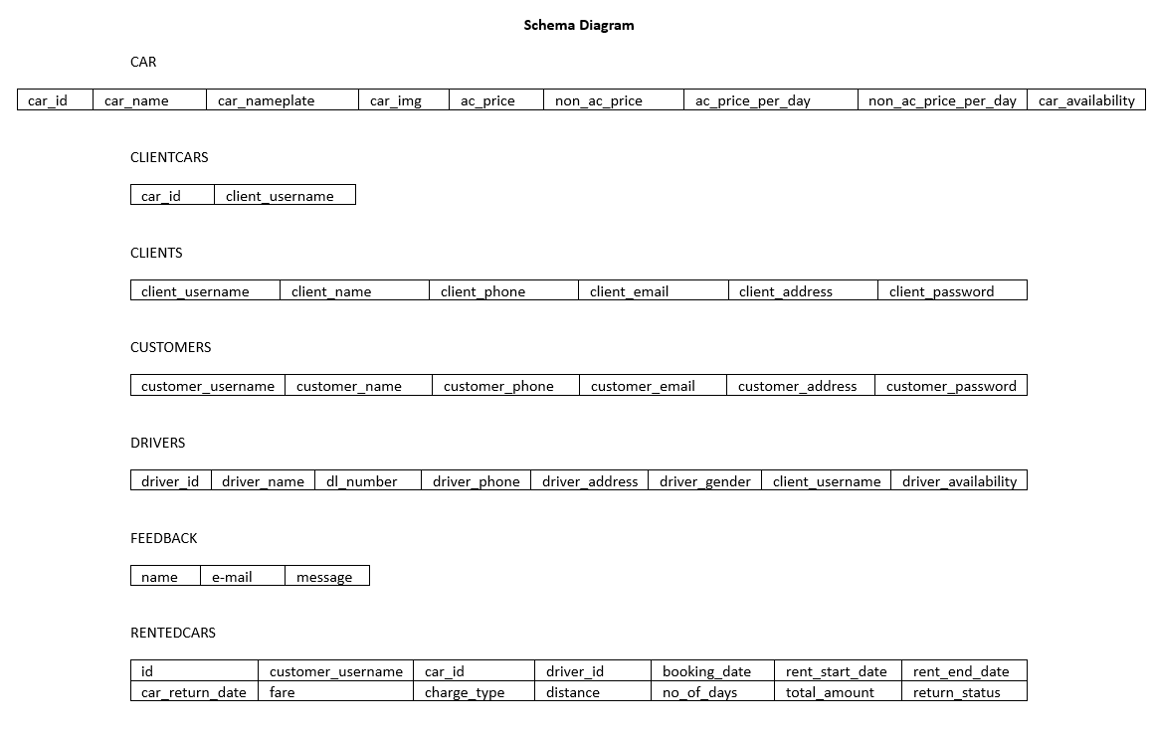
SCHEMA DIAGRAM OF THE MINI WORLD

Slide 6
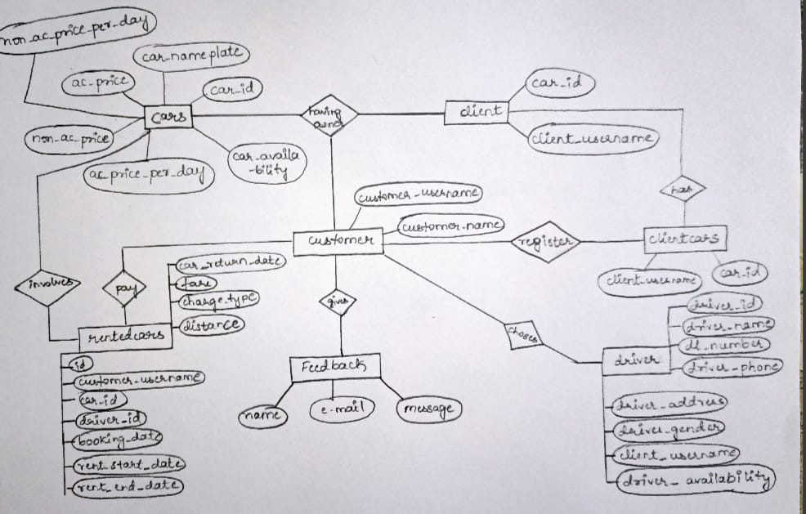
ER DIAGRAM OF THE MINI WORLD

Slide 7
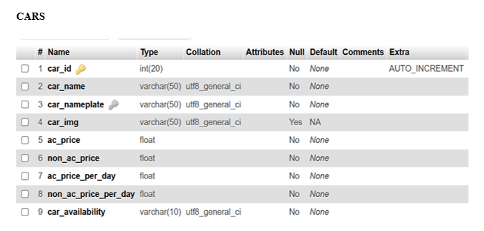
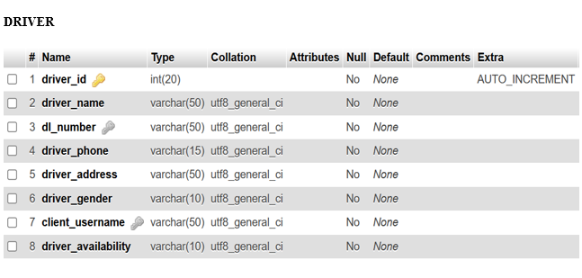
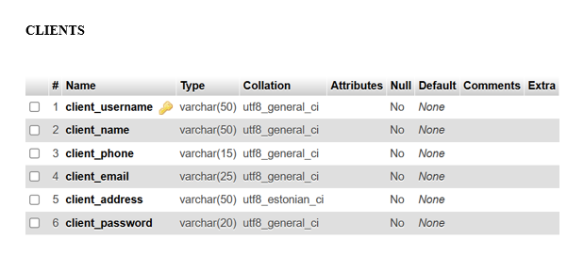
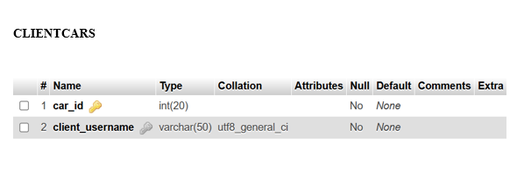
BACKEND DATA (TABLES)

Slide 8
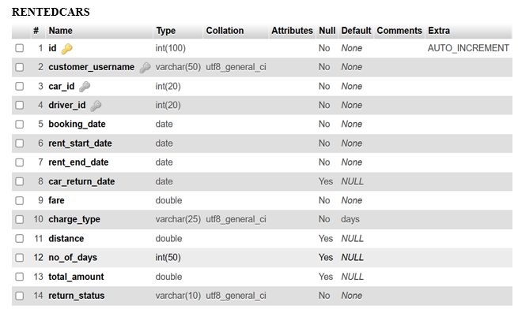
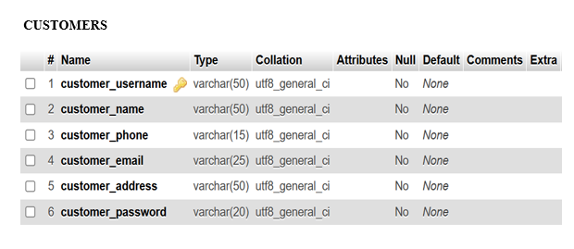
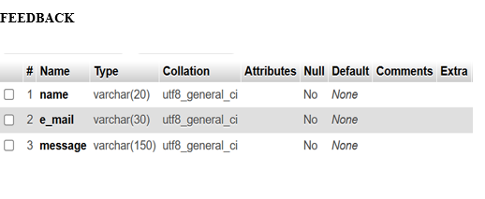
BACKEND DATA (TABLES)

Slide 9

FRONT END SNAPSHOTS OF THE WEBSITE

Slide 10
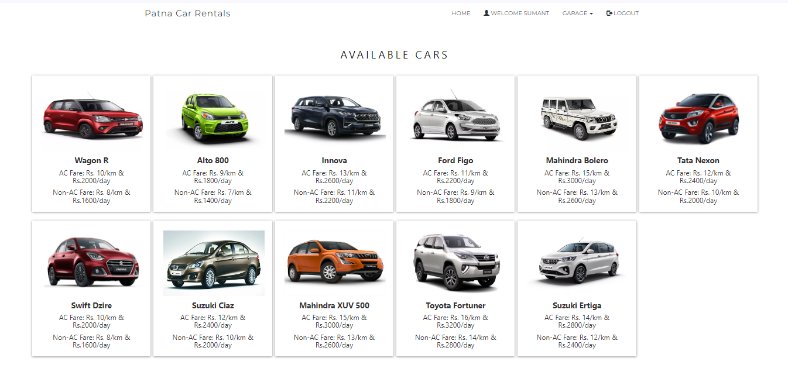
SNAPSHOT OF AVAILABLE CAR

Slide 11
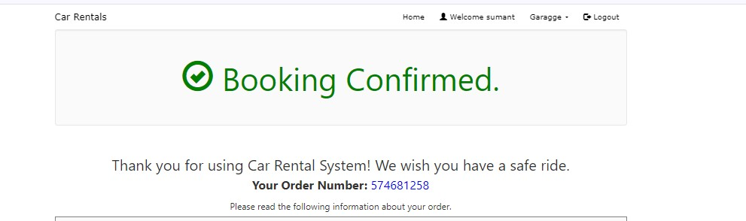
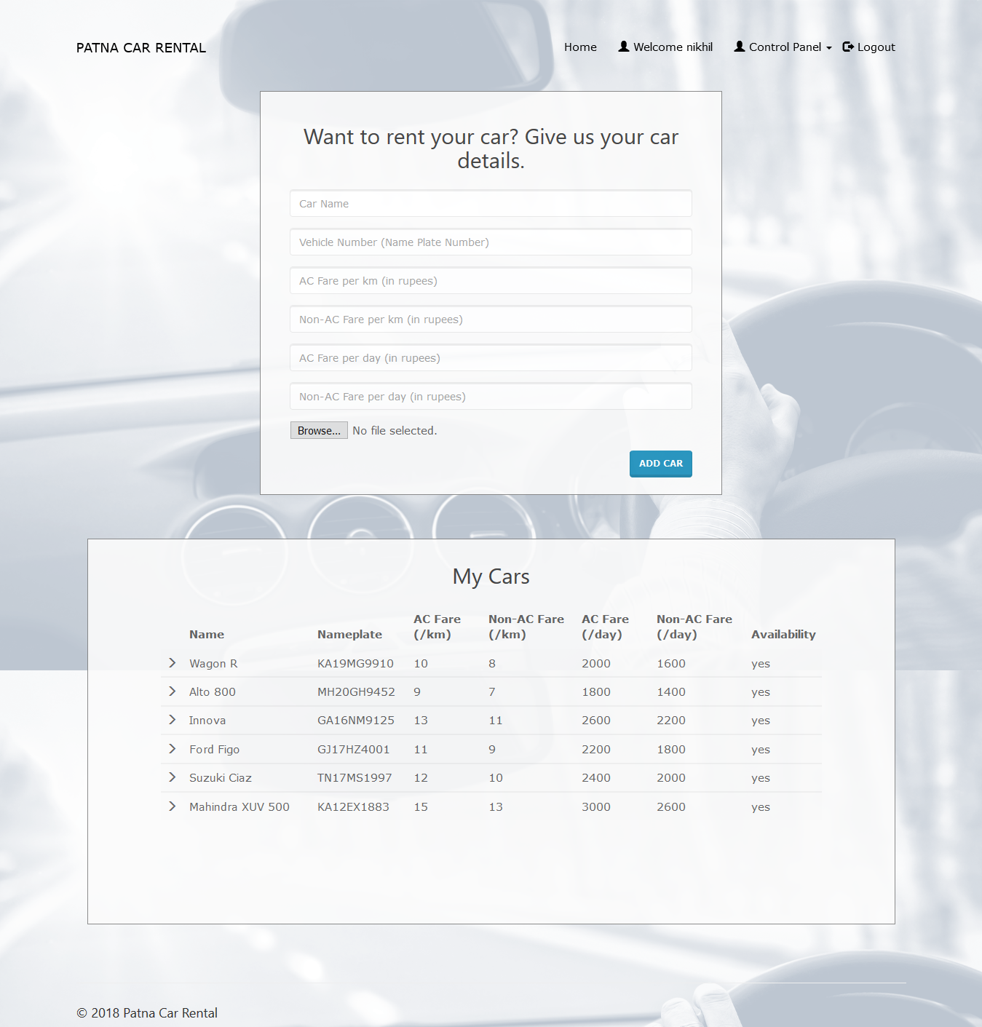
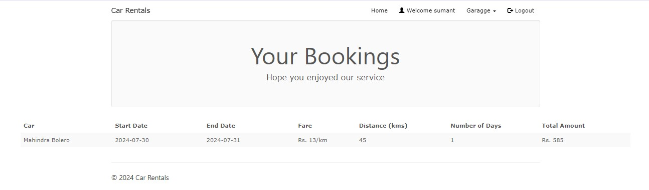
BOOKINGS OF CAR

Slide 12
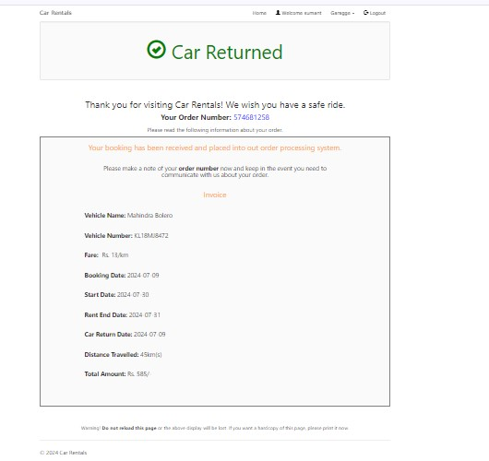
BOOKING RETURNED

Slide 13
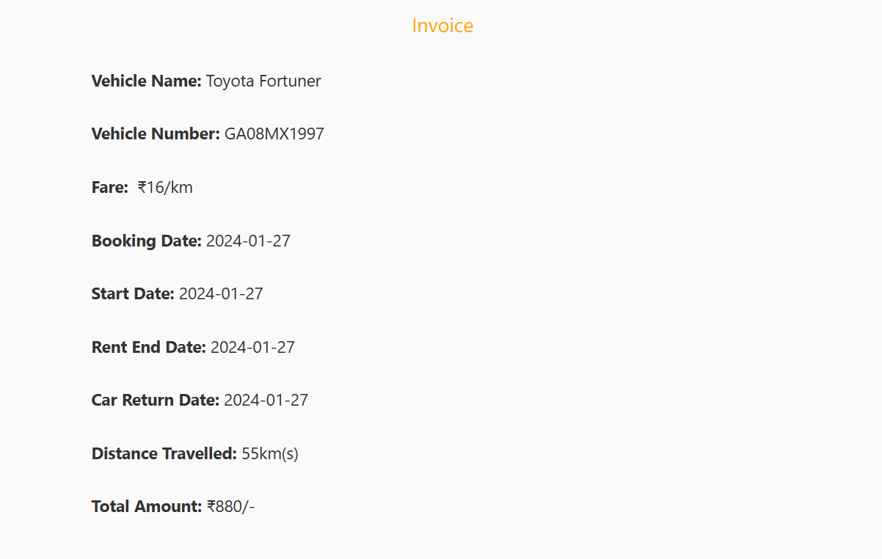
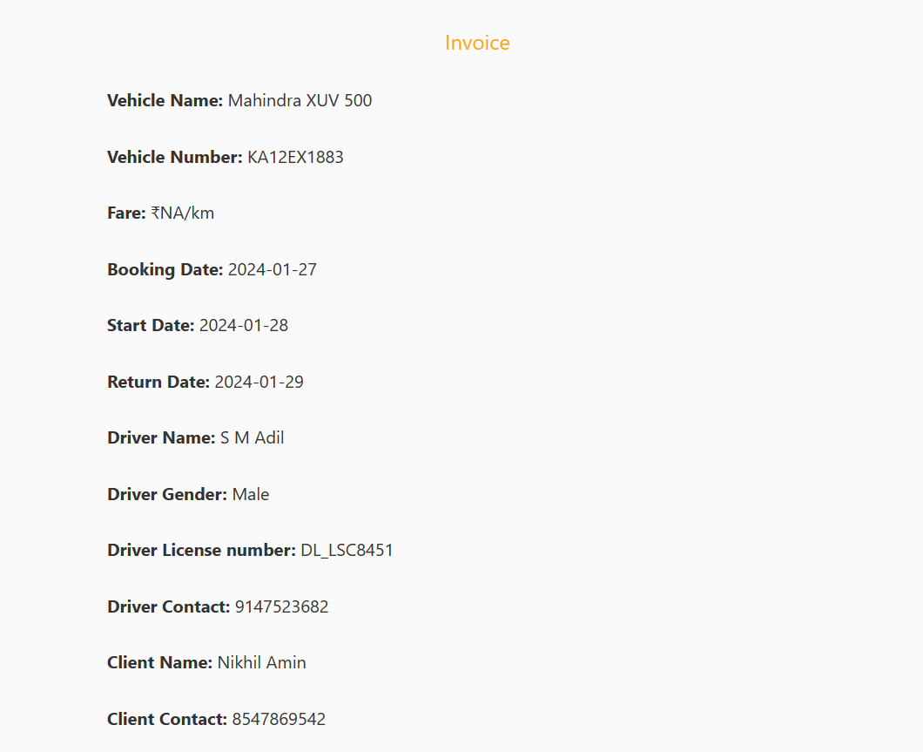
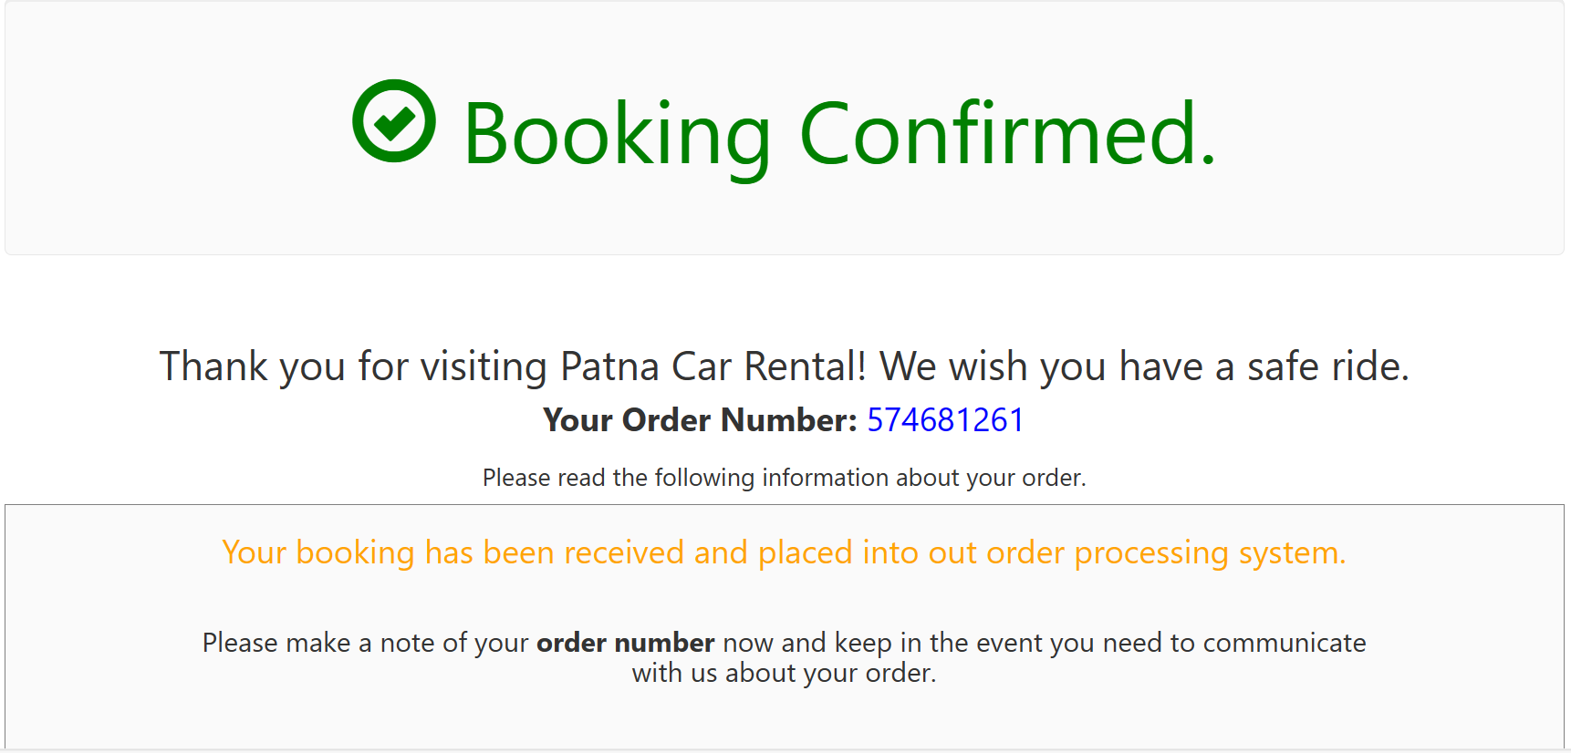

Slide 14
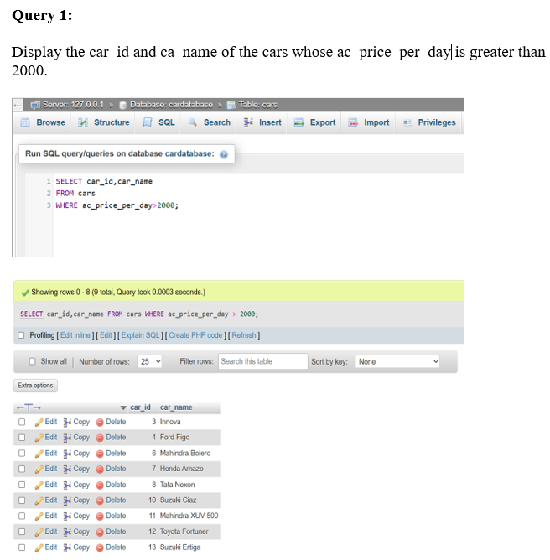
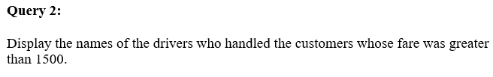
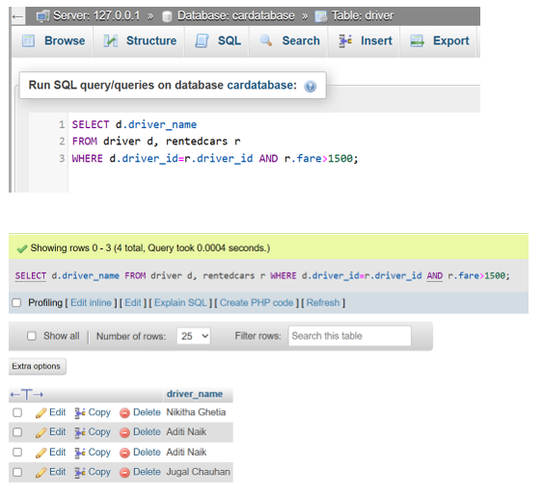
QUERIES

Slide 15
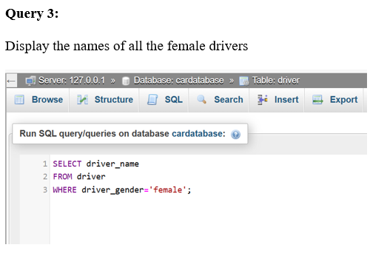
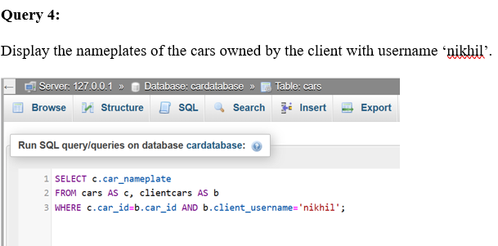
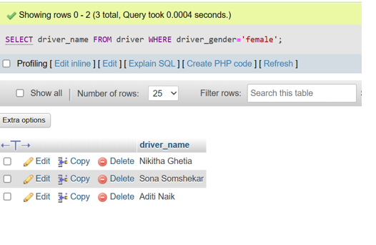
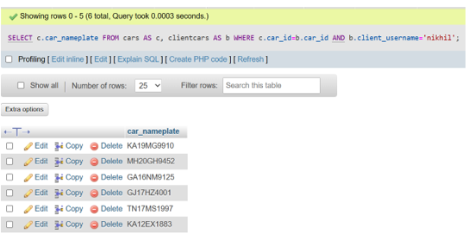
QUERIES

Slide 16
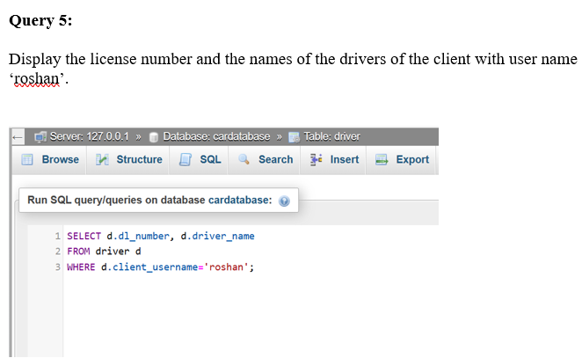
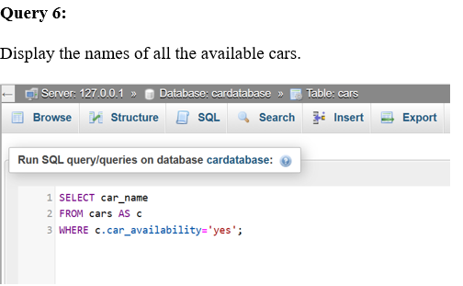
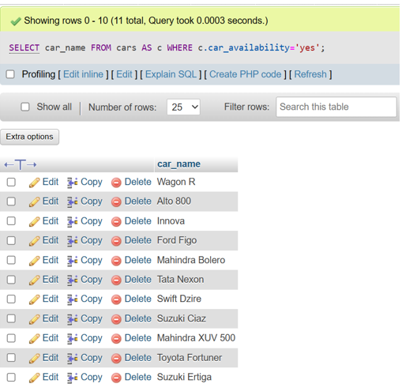
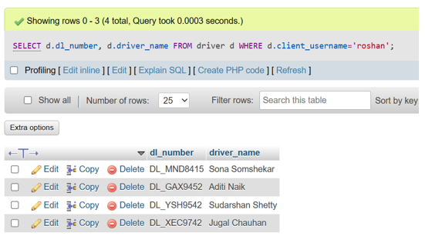
QUERIES

Slide 17
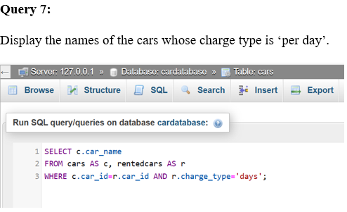
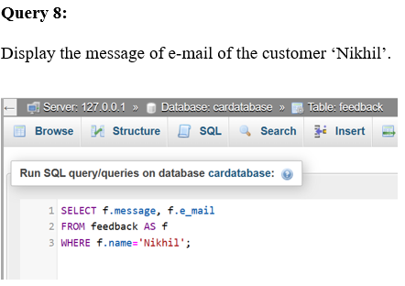
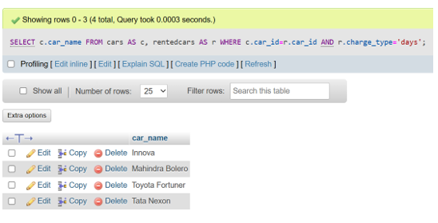
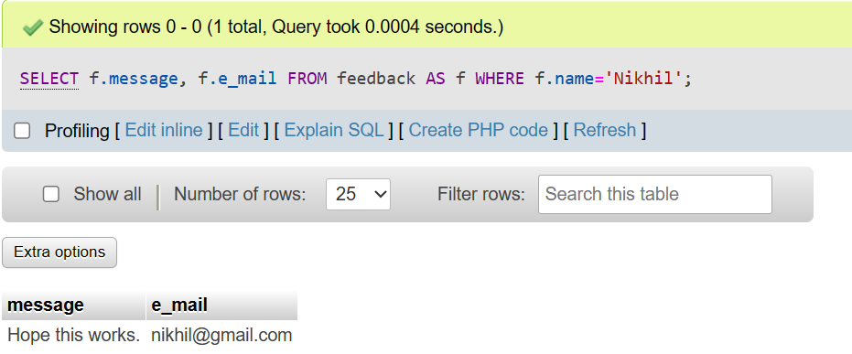
QUERIES

Slide 18
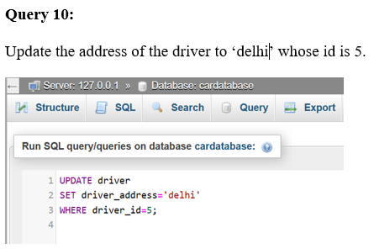
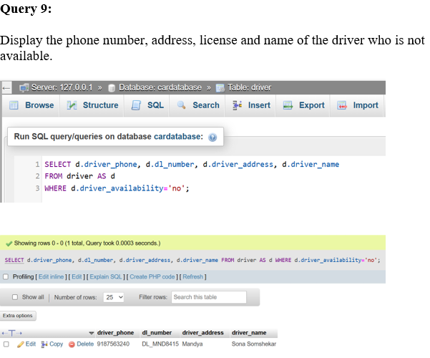
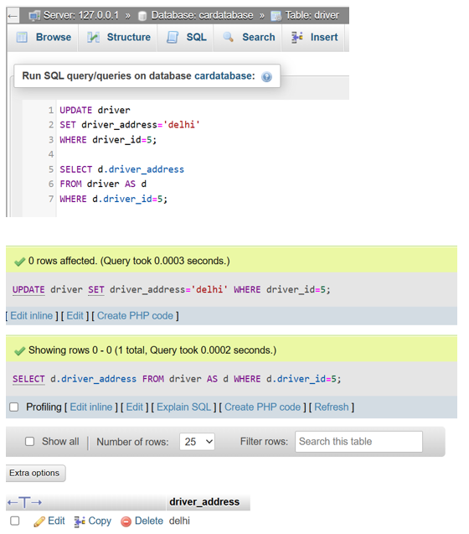
QUERIES

Slide 19
Thank you!

